Slide 1
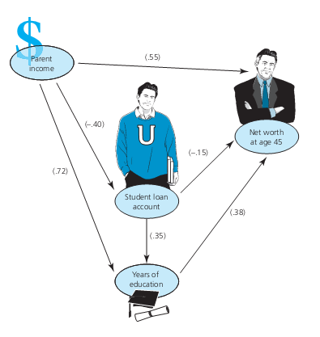
Correlational Research
Chapter Fifteen

Slide 2
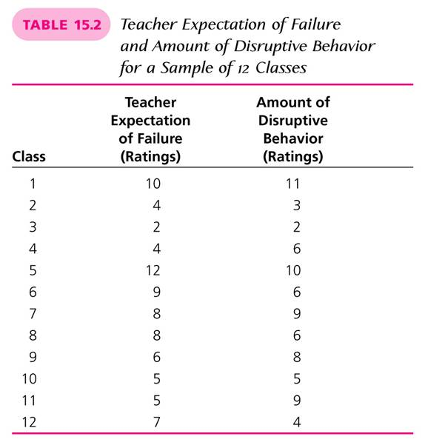
Correlational Research
Chapter Fifteen

Slide 3
The Nature of Correlational Research
Correlational Research is also known as Associational Research.
Relationships among two or more variables are studied without any attempt to influence them.
Investigates the possibility of relationships between two variables.
There is no manipulation of variables in Correlational Research.
Correlational studies describe the variable relationship via a correlation coefficient

Slide 4
Three Sets of Data Showing Different Directions and Degrees of Correlation (Table 15.1)
(A) (B) (C)
r = +1.00 r = -1.00 r = 0
X Y X Y X Y
5 5 5 1 2 1
4 4 4 2 5 4
3 3 3 3 3 3
2 2 2 4 1 5
1 1 1 5 4 2

Slide 5
Purpose of Correlational Research
Correlational studies are carried out to explain important human behavior or to predict likely outcomes (identify relationships among variables).
If a relationship of sufficient magnitude exists between two variables, it becomes possible to predict a score on either variable if a score on the other variable is known (Prediction Studies).
The variable that is used to make the prediction is called the predictor variable.

Slide 6
Purpose of Correlational Research
(cont.)
The variable about which the prediction is made is called the criterion variable.
Both scatterplots and regression lines are used in correlational studies to predict a score on a criterion variable
A predicted score is never exact. Through a prediction equation (see p. 585), researchers use a predicted score and an index of prediction error (standard error of estimate) to conclude if the score is likely to be incorrect.

Slide 7
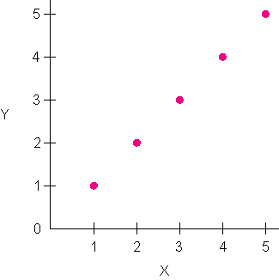
Scatterplot Illustrating a Correlation of +1.00

Slide 8
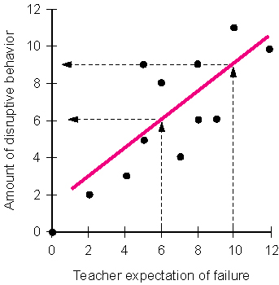
Prediction Using a Scatterplot (Figure 15.2)

Slide 9
More Complex Correlational Techniques
Multiple Regression
    Technique that enables researchers to determine a correlation between a criterion variable and the best combination of two or more predictor variables
Coefficient of multiple correlation (R)
    Indicates the strength of the correlation between the combination of the predictor variables and the criterion variable
Coefficient of Determination
    Indicates the percentage of the variability among the criterion scores that can be attributed to differences in the scores on the predictor variable

Slide 10
More Complex Correlational Techniques
Discriminant Function Analysis
    Rather than using multiple regression, this technique is used when the criterion value is categorical
Factor Analysis
    Allows the researcher to determine whether many variables can be described by a few factors
Path Analysis
    Used to test the likelihood of a causal connection among three or more variables
Structural Modeling
    Sophisticated method for exploring and possibly confirming causation among several variables

Slide 11
Scatterplot Illustrating a Correlation of +1.00

Slide 12
Prediction Using a Scatterplot

Slide 13
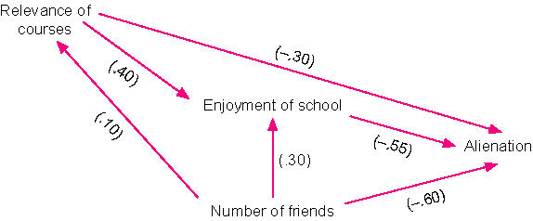
Path Analysis Diagram

Slide 14
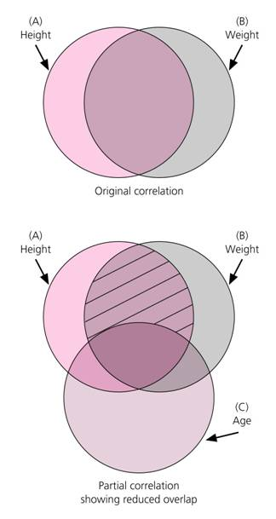
Partial Correlation

Slide 15
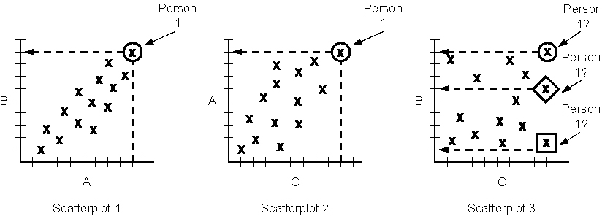
Scatterplots Illustrating How a Factor May Not be a Threat to Internal Validity

Slide 16
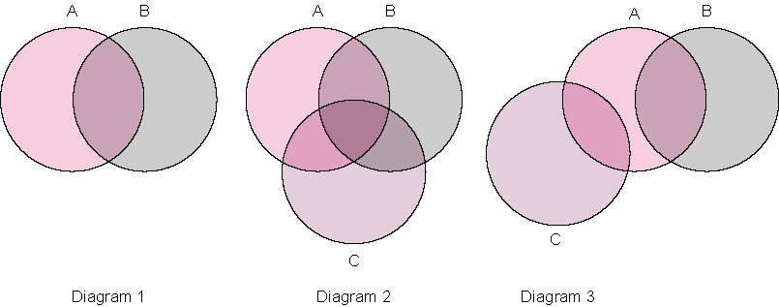
Circle Diagrams Illustrating Relationships Among Variables

Slide 17
Basic Steps in Correlational Research
Determining design and procedures
Collecting and analyzing data
Interpreting results
Problem selection
Choosing a sample
Selecting or choosing proper instruments

Slide 18
What Do Correlational Coefficients Tell Us?
The meaning of a given correlation coefficient depends on how it is applied.
Correlation coefficients below .35 show only a slight relationship between variables.
Correlations between .40 and .60 may have theoretical and/or practical value depending on the context.
Only when a correlation of .65 or higher is obtained, can one reasonably assume an accurate prediction.
Correlations over .85 indicate a very strong relationship between the variables correlated.

Slide 19
Threats to Internal Validity in Correlational Research
Subject characteristics
Mortality
Location
Instrument decay
Testing
History
Data collector characteristics
Data collector bias

